Slide 1
Minor Project-2
Project Title:-
JEEVANDAN: Blood Bank Management System
Project No-59
Members:
Esha Mitra (201b107)
Navanshu (201b164)
Prince Katare (201b197)
Guide : Dr. Kunj Bihari Meena

Slide 2
Index
SNo. | Topic | Page No.
1. | Introduction | 1
2. | Purpose | 2
3. | Scope | 3-4
4. | Interfaces | 5-6
5. | Requirements | 7-8
6. | Software Process Model | 9
7. | Use Case Diagram | 10
6. | Feasibility | 11
7. | Technologies used | 12-13
8. | Snapshots of the project | 14-20
9. | Conclusion | 21
10. | References | 22

Slide 3
Introduction
Every day an average of 12000 individuals die due to lack of quality blood.
1 person donating healthy blood can save up to 3 lives.
We call for relatives, blood banks and ask people to help through social media when we are in urgent need of blood.
JEEVANDAN can help people reach out to the donor directly without delay which can further save thousands of lives.

Slide 4
Purpose
JEEVANDAN – A Blood Bank Management System
Users can find a suitable donor according to their blood group.
Without wandering anywhere, donor’s availability will be indicated.
People in need can reach out to the donors without delay from external sources such as blood banks , hospitals etc.

Slide 5
Scope
JEEVANDAN will help patients get blood easily , without delay, saving lives.
It will help avoid the hassle of hospitals as well as patient’s kin in finding donors.
The users can be donors as well as receivers.
The donors can be directly in touch with their receivers, and vice versa, making a healthy and helpful community.

Slide 6
Scope (cont..)
The system functions and features will briefly include :
Registration of user : Login and signup.
Information entry for donor.
Search bar to search for donor with the help of blood group.
Managing record of donors.
Availability of donors ( we can donate blood once in every 120 days).

Slide 7
Interfaces
User Interfaces
The UI will be compatible with any browser such as Chrome , Mozilla , Edge etc.
This will help the user to access the system.
Hardware Interfaces
Since the application runs over internet , the network interface is necessary such as Wi-Fi or 3G/4G internet connectivity for better experience.

Slide 8
Interfaces (cont..)
Software Interfaces
The data of the project will be maintained in a database (No-SQL ) which is MongoDB.
The MERN stack will be used a tech stack.
Communication Interfaces
We will use the http protocol for the communication over internet.
The UI will be displayed in English, for easy use of variety users.

Slide 9
Hardware Requirements
A Laptop / desktop with :
Minimum 512 Mb RAM
Single core 2GHz preprocessor.
Disk space of at least 2 GB required for using Visual Studio code.
(depending on the IDE and tech stack, the requirements might vary)

Slide 10
Software Requirements
For file sharing and storing :
MongoDB : database management software.
Express.js : server side development and a middleware for Node.js
React.js (HTML, CSS, JS) for UI development.
Web browsers such as Chrome , Microsoft Bing, Edge, etc.
IDE : software development environment such as Visual Studio code, JetBrains etc.

Slide 11
Waterfall Model
Communication
Planning
Modelling and
Design
Development
Deployment
The waterfall model is a linear software development approach where each phase must be completed before moving on to the next.
We will work on our project in the waterfall approach.
9

Slide 12
Use Case Diagram
User Login/Signup
Check Dashboard
Donor
Donate Blood
Patient
Check Blood Bank
Receive Blood
10

Slide 13
Feasibility Study
TECHNICAL
ECONOMICAL
OPERATIONAL
Project requires the knowledge of MERN stack as a whole.
Basic UI (frontend) technologies as well as database like MongoDB and express.js for server requirements.
Apart from laptop, no hardware cost is required.
No additional software purchases as well as easy to use open source applications are used.
Implementation is also comparatively easy.
Maintenance cost is negligible.
Product will be available to everyone and the interface will be easy to use.

Slide 14
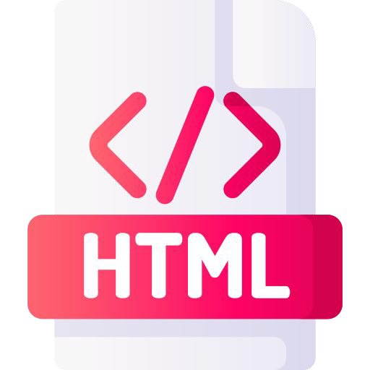
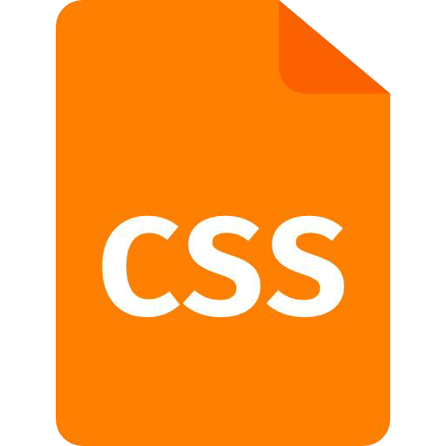
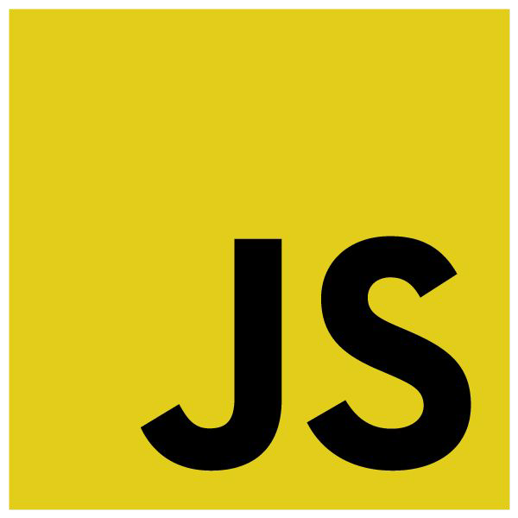

Frontend
The standard markup language for documents designed to be displayed in a web browser.
CSS is used to beautify the webpages.
It is a interpreted programming language used to create interactive effects within web browsers.
React.js is the JavaScript framework used as an UI tool.
12

Slide 15

Backend
NodeJs
ExpressJs
Using MongoDb as a database.
13

Slide 16
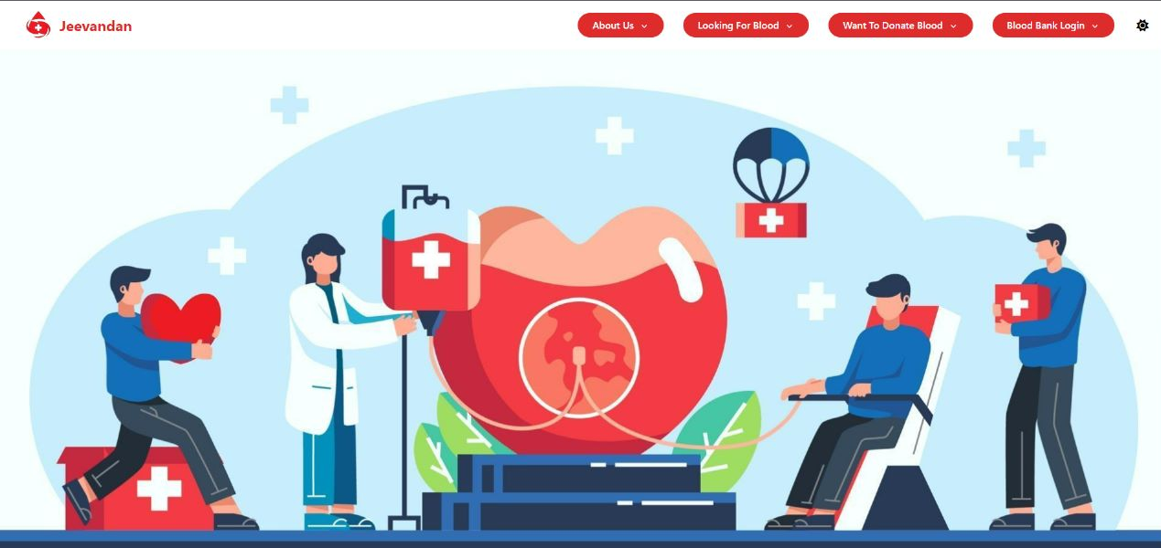
Home/Landing Page

Slide 17
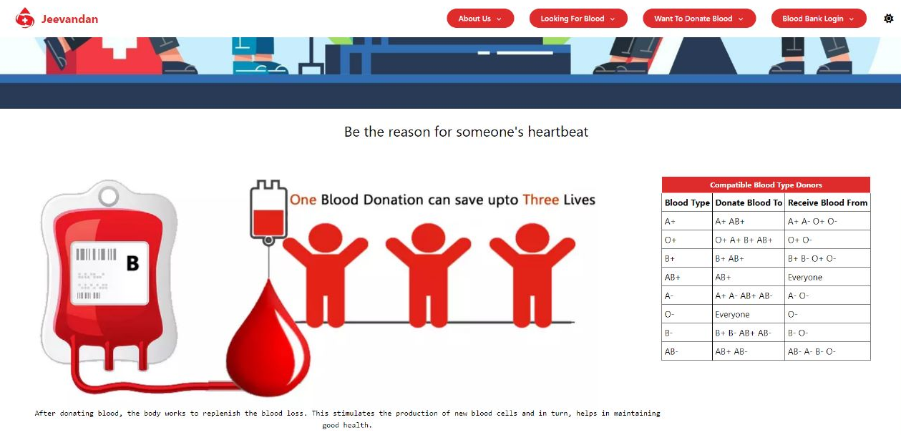
Home/Landing Page (cont..)

Slide 18
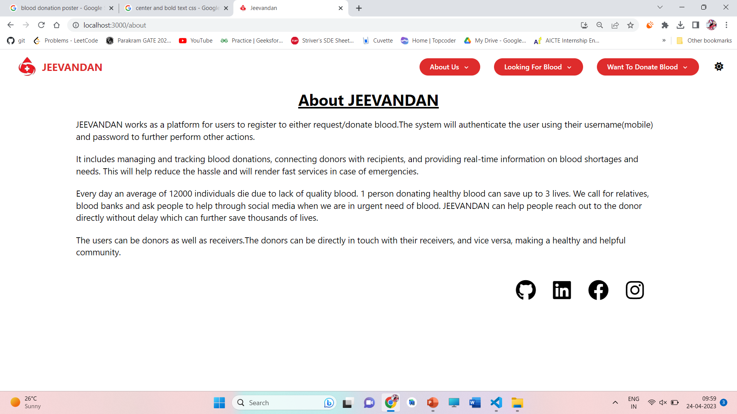
About us page

Slide 19
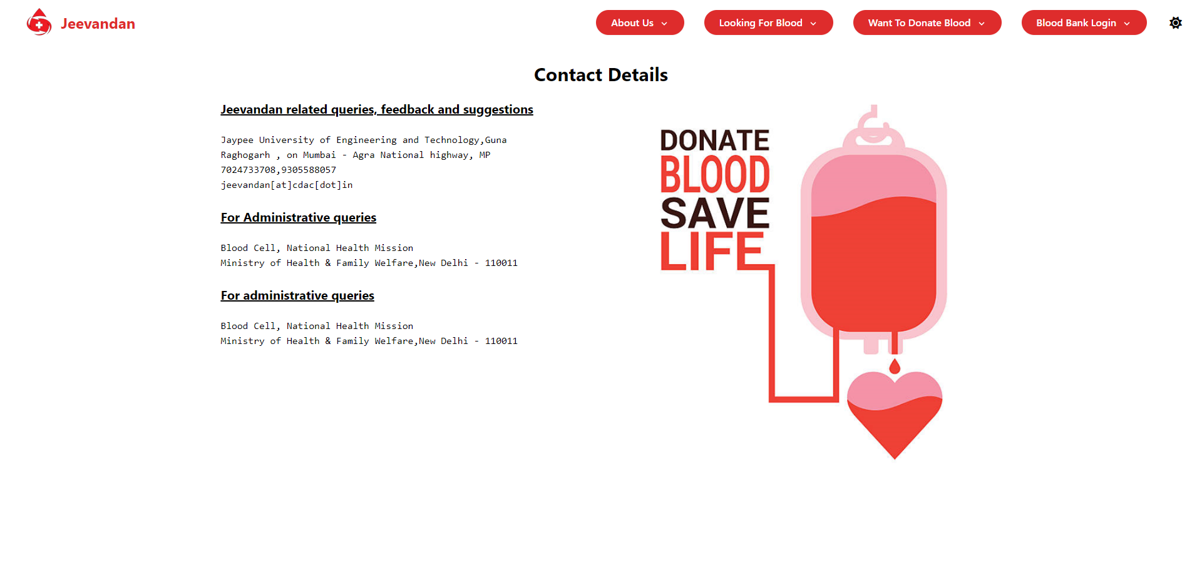
Contact Details page

Slide 20
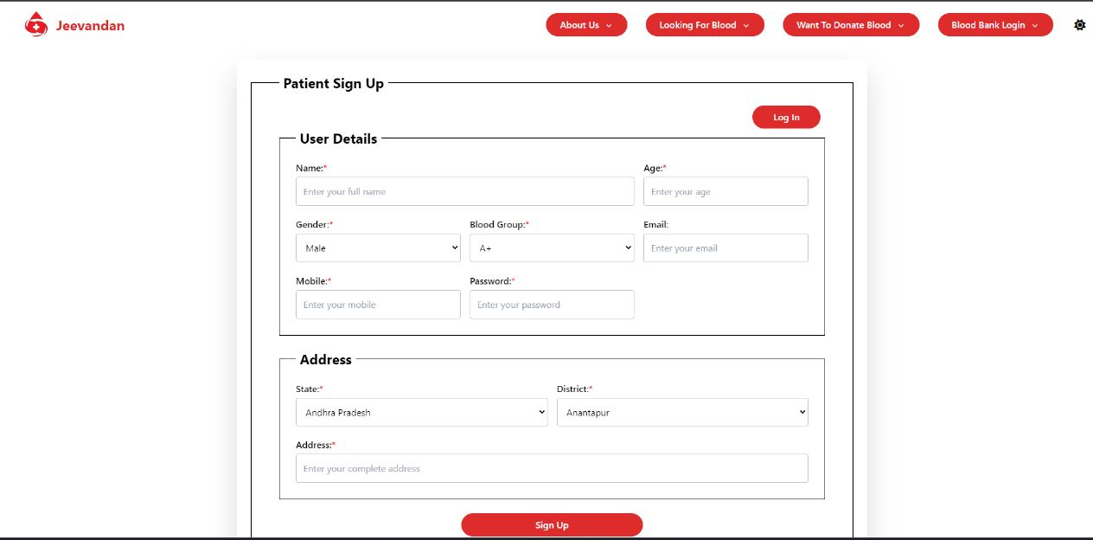
Receiver Login/Signup page

Slide 21

Donor Login/Signup page

Slide 22
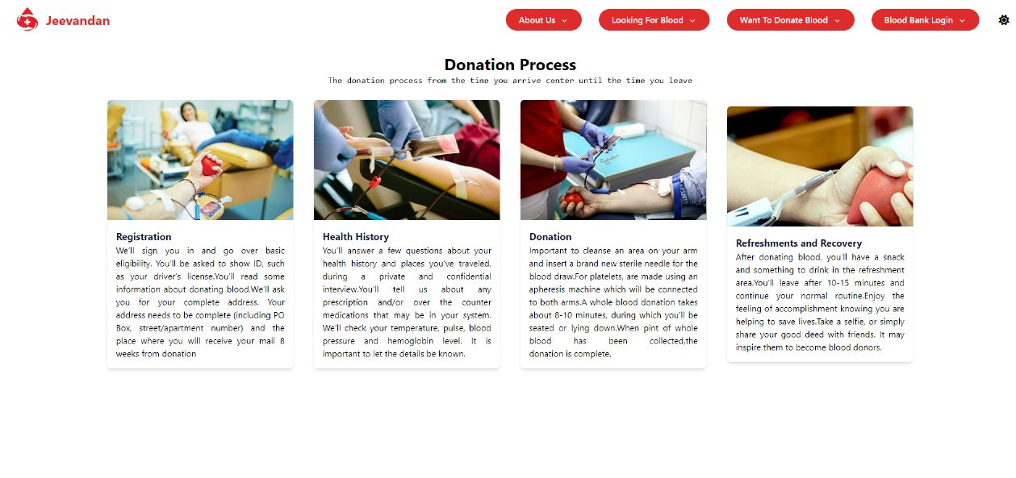
About Donations Page

Slide 23
Conclusion
We aim to build a web application which will be easy to use and will help reduce the time and effort to save lives in blood donation scenarios.

Slide 24
References
[1] N. I. Naim, “ ReactJS: An Open Source JavaScript library for front-end development ,” Bachelor of Engineering , Dept. Information Technology , Metropolia University of Applied Sciences , 2017 [Accessed : 29-Jan -2023]
[2] H. Shah, “ Node.js Challenges in Implementation ,” Master of Science, Dept. Computer Science , SZABIST , Dubai , 2017 [Accessed : 8-Feb-2023]
[3] Geeks for Geeks (2022, Apr. 19). Express.js Application Complete Reference [Online]. Available: https://www.geeksforgeeks.org/express-js-application-complete-reference/ [Accessed : 20-Feb-2023]

Slide 25
THANK YOU !!

